Slide 1
Introduction to Artificial Intelligence
The Fundamentals of Machine Learning
End-to-End Machine Learning Project
Classification
Training Models
Decision tree

Slide 2
Chapter 2
End-to-End Machine Learning Project
Working with Real Data
Look at the Big Picture (Frame the Problem)
Select a Performance Measure
Take a Quick Look at the Data Structure
Create a Test Set
Discover and Visualize the Data to Gain Insights
Visualizing Geographical Data
Looking for Correlations
Experimenting with Attribute Combinations
Prepare the Data for Machine Learning Algorithms (Data Cleaning)
Select and Train a Model
Fine-Tune Your Model
Ensemble Methods
Analyze the Best Models and Their Errors
Evaluate Your System on the Test Set

Slide 3
Working with real data
In this chapter we’ll use the California Housing Prices dataset from the StatLib repository2 . This dataset is based on data from the 1990 California census. It is not exactly recent, but it has many qualities for learning, so we will pretend it is recent data. For teaching purposes I’ve added a categorical attribute and removed a few features.
Notes:
Popular open data repositories
UC Irvine Machine Learning Repository
Kaggle datasets
Amazon’s AWS datasets
Meta portals (they list open data repositories)
Data Portals
OpenDataMonitor
Quandl
Other pages listing many popular open data repositories
Wikipedia’s list of Machine Learning datasets
Quora.com
The datasets subreddit

Slide 4
Look at the big picture
The first question to ask your boss is what exactly the business objective is?
The next question to ask your boss is what the current solution looks like? (if any)
With all this information, you are now ready to start designing your system. First, you need to frame the problem: is it supervised, unsupervised, or Reinforcement Learning? Is it a classification task, a regression task, or something else? Should you use batch learning or online learning techniques? Before you read on, pause and try to answer these questions for yourself.

Slide 5
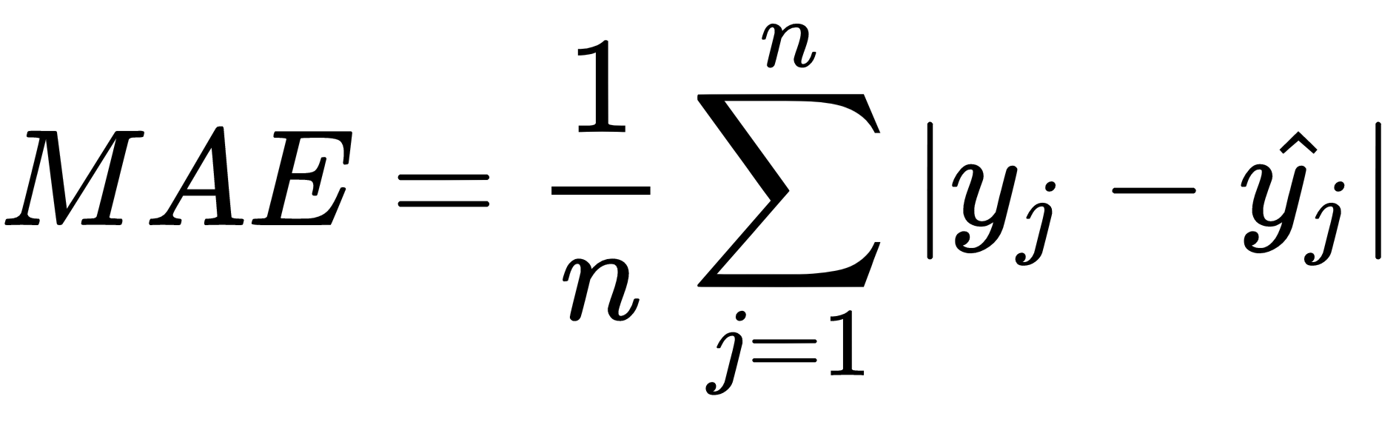
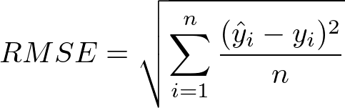
Select a Performance Measure
Notes:
the RMSE is more sensitive to outliers than the MAE. But when outliers are rare, the RMSE performs very well and is generally preferred.

Slide 6
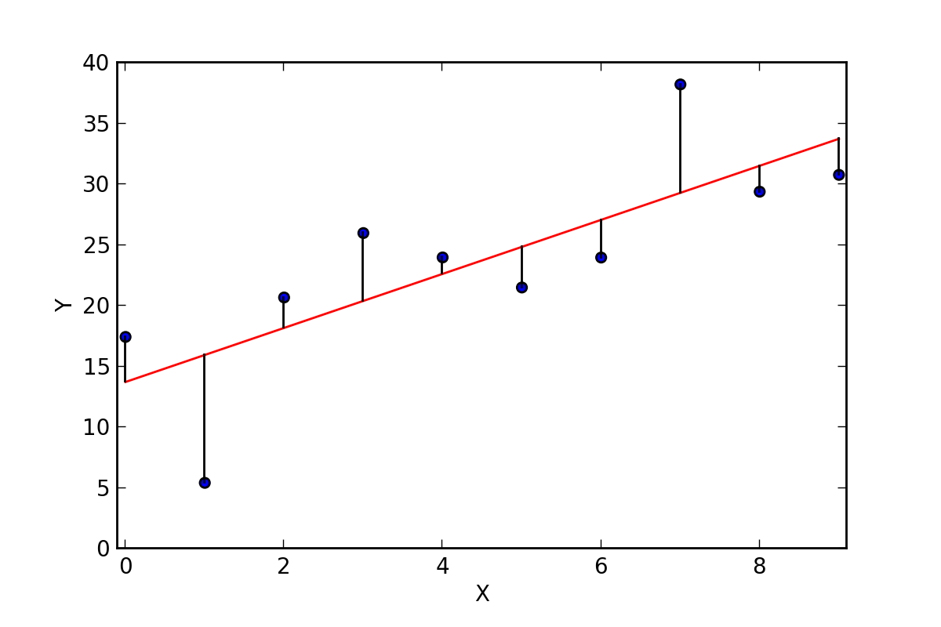

Slide 7
Take a Quick Look at the Data Structure
Use info and describe
Use value_counts
Draw some plots
etc…

Slide 8

WARNING
Wait! Before you look at the data any further, you need to create a test set, put it aside, and never look at it
Create a Test Set
Creating a test set is theoretically simple: pick some instances randomly, typically 20% of the dataset (or less if your dataset is very large)
Notes:
It may sound strange to voluntarily set aside part of the data at this stage. After all, you have only taken a quick glance at the data, and surely you should learn a whole lot more about it before you decide what algorithms to use, right? This is true, but your brain is an amazing pattern detection system, which means that it is highly prone to overfitting: if you look at the test set, you may stumble upon some seemingly interesting pattern in the test data that leads you to select a particular kind of Machine Learning model. When you estimate the generalization error using the test set, your estimate will be too optimistic, and you will launch a system that will not perform as well as expected. This is called data snooping bias.

Slide 9
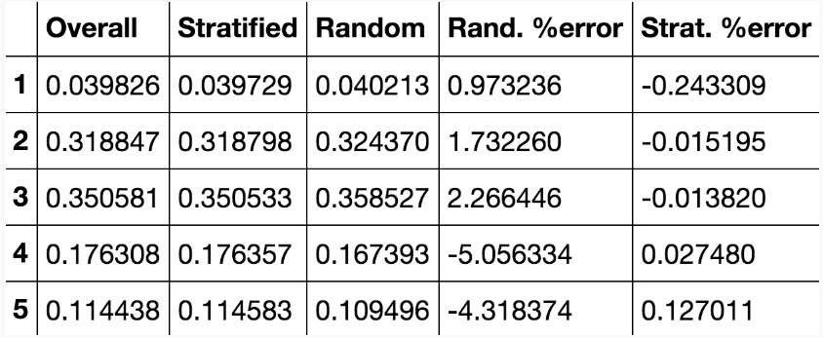
Stratified Sampling

Slide 10
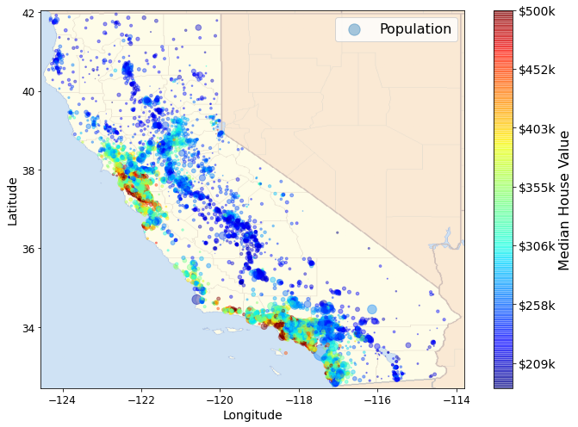
Discover and Visualize the Data to Gain Insights
Visualizing Geographical Data

Slide 11
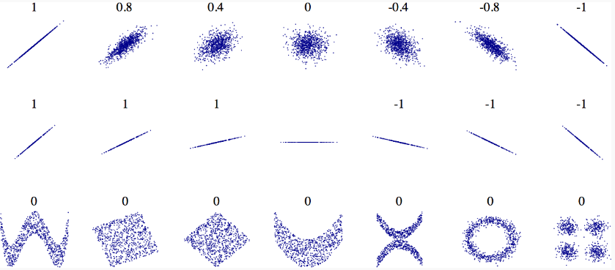
Looking for Correlations
Notes:
The correlation coefficient only measures linear correlations (“if x goes up, then y generally goes up/down”). It may completely miss out on nonlinear relationships (e.g., “if x is close to 0, then y generally goes up”). Note how all the plots of the bottom row have a correlation coefficient equal to 0, despite the fact that their axes are clearly not independent: these are examples of nonlinear relationships. Also, the second row shows examples where the correlation coefficient is equal to 1 or –1; notice that this has nothing to do with the slope. For example, your height in inches has a correlation coefficient of 1 with your height in feet or in nanometers.

Slide 12
Experimenting with Attribute Combinations
Think and try to create new features by yourself
💡

Slide 13
Prepare the Data for Machine Learning Algorithms
you should write functions for this purpose, for several good reasons:
This will allow you to reproduce these transformations easily on any dataset (e.g., the next time you get a fresh dataset).
You will gradually build a library of transformation functions that you can reuse in future projects.
You can use these functions in your live system to transform the new data before feeding it to your algorithms.
This will make it possible for you to easily try various transformations and see which combination of transformations works best.

Slide 14
Handle missing data
Most Machine Learning algorithms cannot work with missing features. We saw earlier that the total_bedrooms attribute has some missing values, so let’s fix this. You have three options:
Get rid of the corresponding districts. dropna()
Get rid of the whole attribute. drop()
Set the values to some value (zero, the mean, the median, etc.). fillna()
If you choose option 3, you should compute the median value on the training set and use it to fill the missing values in the training set. Don’t forget to save the median value that you have computed. You will need it later to replace missing values in the test set when you want to evaluate your system, and also once the system goes live to replace missing values in new data.

Slide 15
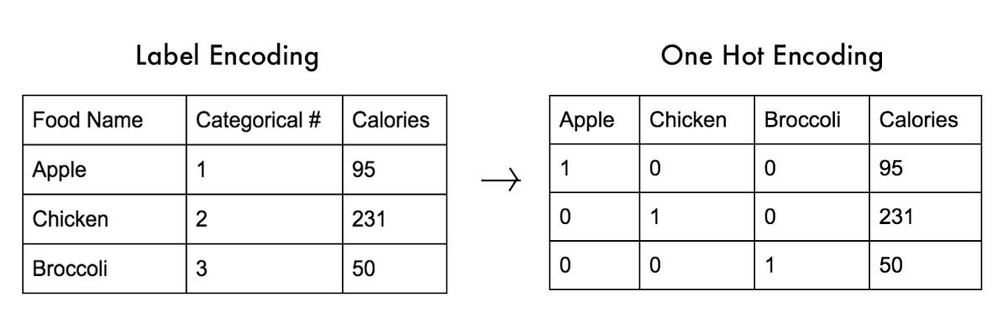
Handling Text and Categorical Attributes

Slide 16

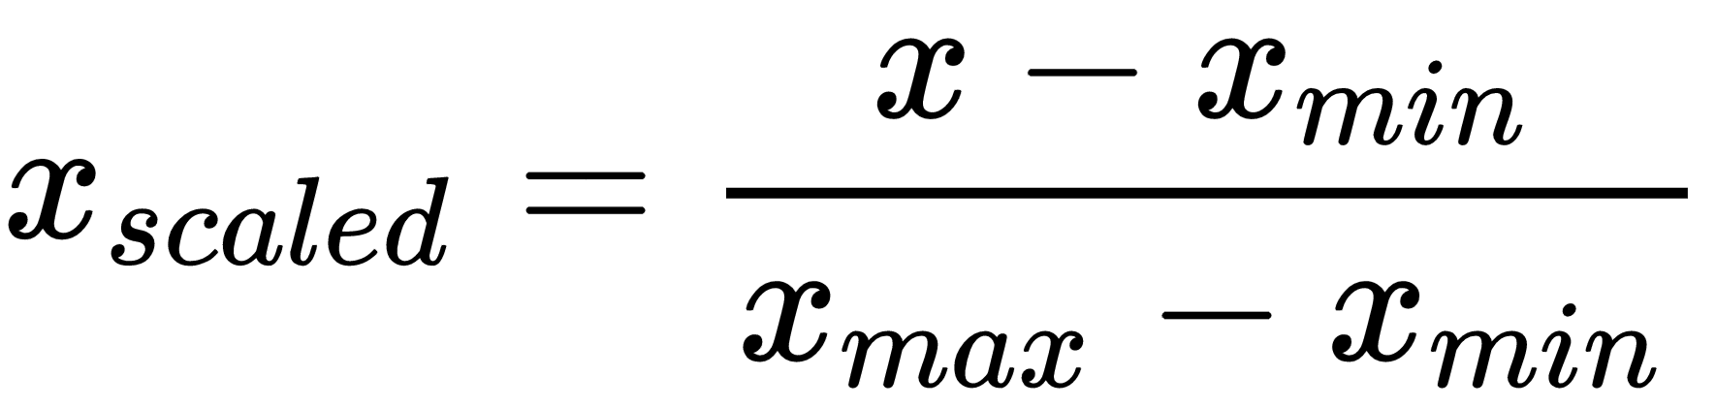
Feature Scaling
standardization
Min-Max scaling
WARNING
As with all the transformations, it is important to fit the scalers to the training data only, not to the full dataset (including the test set). Only then can you use them to transform the training set and the test set (and new data)
Notes:
One of the most important transformations you need to apply to your data is feature scaling. With few exceptions, Machine Learning algorithms don’t perform well when the input numerical attributes have very different scales. This is the case for the housing data: the total number of rooms ranges from about 6 to 39,320, while the median incomes only range from 0 to 15. Note that scaling the target values is generally not required.
There are two common ways to get all attributes to have the same scale: min-max scaling and standardization.
Min-max scaling (many people call this normalization) is the simplest: values are shifted and rescaled so that they end up ranging from 0 to 1. We do this by subtracting the min value and dividing by the max minus the min. Scikit-Learn provides a transformer called MinMaxScaler for this. It has a feature_range hyperparameter that lets you change the range if, for some reason, you don’t want 0–1.
Standardization is different: first it subtracts the mean value (so standardized values always have a zero mean), and then it divides by the standard deviation so that the resulting distribution has unit variance. Unlike min-max scaling, standardization does not bound values to a specific range, which may be a problem for some algorithms (e.g., neural networks often expect an input value ranging from 0 to 1).
However, standardization is much less affected by outliers. For example, suppose a district had a median income equal to 100 (by mistake). Min-max scaling would then crush all the other values from 0–15 down to 0–0.15, whereas standardization would not be much affected.

Slide 17
Select and Train a Model
Linear regression
Decision Tree
Random forest
SVR
Fine-Tune Your Model
Grid Search
Randomized Search
Analyze the Best Models and Their Errors
Evaluate Your System on the Test Set

Slide 18
Questions?

